Slide 1
Center for Prevention Programs and Partnerships
Presented by:
Robert F. Mahoney
Regional Prevention Coordinator (Boston); U.S. Department of Homeland Security
Center for Prevention Programs & Partnerships
www.dhs.gov/cp3
617-519-3791 (mobile)
robert.mahoney@hq.dhs.gov

Slide 2
What is the Center for Prevention Programs and Partnerships?
Vision
The Center for Prevention Programs and Partnerships (CP3) seeks a resilient America where communities are united to help end targeted violence and terrorism.
The Center for Prevention Programs and Partnerships (CP3) is a center within the Department of Homeland Security (DHS) which works with communities to prevent acts of targeted violence and terrorism - which include attacks on schools, workplaces, public gatherings, and other settings
CP3 offers educational, technical, and financial support to help community efforts support violence prevention initiatives with states, localities, Tribes, territories
Center for Prevention Programs and Partnerships

Slide 3




Center for Prevention Programs and Partnerships (CP3) Overview
Vision: The Center for Prevention Programs and Partnerships (CP3) seeks a resilient America where communities are united to help end targeted violence and terrorism.
CP3 provides…
Prevention Approach
Help establish and empower local networks that connect all segments of society to prevent targeted violence and terrorism by getting help to individuals who may be radicalizing, or have radicalized, to violence:
Educational Support
Educational Support
  Ex) Briefings, access to resources, informational products, messaging campaigns
Technical Support
Technical Support
  Ex) Information sharing, convening stakeholders, skills training, and consultation services
Financial Support
Public Awareness & Engagement
Threat Assessment & Management
Financial Support
Support Services
  Ex) Targeted violence and terrorism prevention grants program
Website: www.dhs.gov/CP3 Listserv: https://public.govdelivery.com/accounts/USDHS/subscriber/new

Slide 4
Prevention is Locally-Led
The success of a targeted violence and terrorism prevention program depends on dedicated partners from all sectors of society working together.
The goal is to prevent terrorism and targeted violence by getting help to individuals who may be radicalizing, or have radicalized, to violence
The idea behind prevention is that an informed public can recognize concerning behaviors before an attack, reach out to a trained team or professional in a school, clinic, or law enforcement agency that can intervene, and connect the individual and their family with the help they need to pull them away from violence.
Each community is unique – with different resources, demographics, infrastructures, political climates, local needs, and relationship challenges. Locally-led efforts work best when they are:
  Developed by the community
  Contain multiple levels of prevention
  Use strategies of prevention that work within the community
Notes:
This means we work with mental health, social service, public health, public safety, academic, and other multi-disciplinary partners, like those here today, to reduce the chances that people in a society radicalize to violence in the first place and provide support to those who need help leaving the pathway to violence.
RPCs interact with community partners to better understand the unique local dynamics in their areas of responsibility An effective plan of action to prevent targeted violence convenes all parts of the local community to build and sustain trusted partnerships to promote:
Public awareness and education,
Threat Assessment and Management,
And Support Services

Slide 5
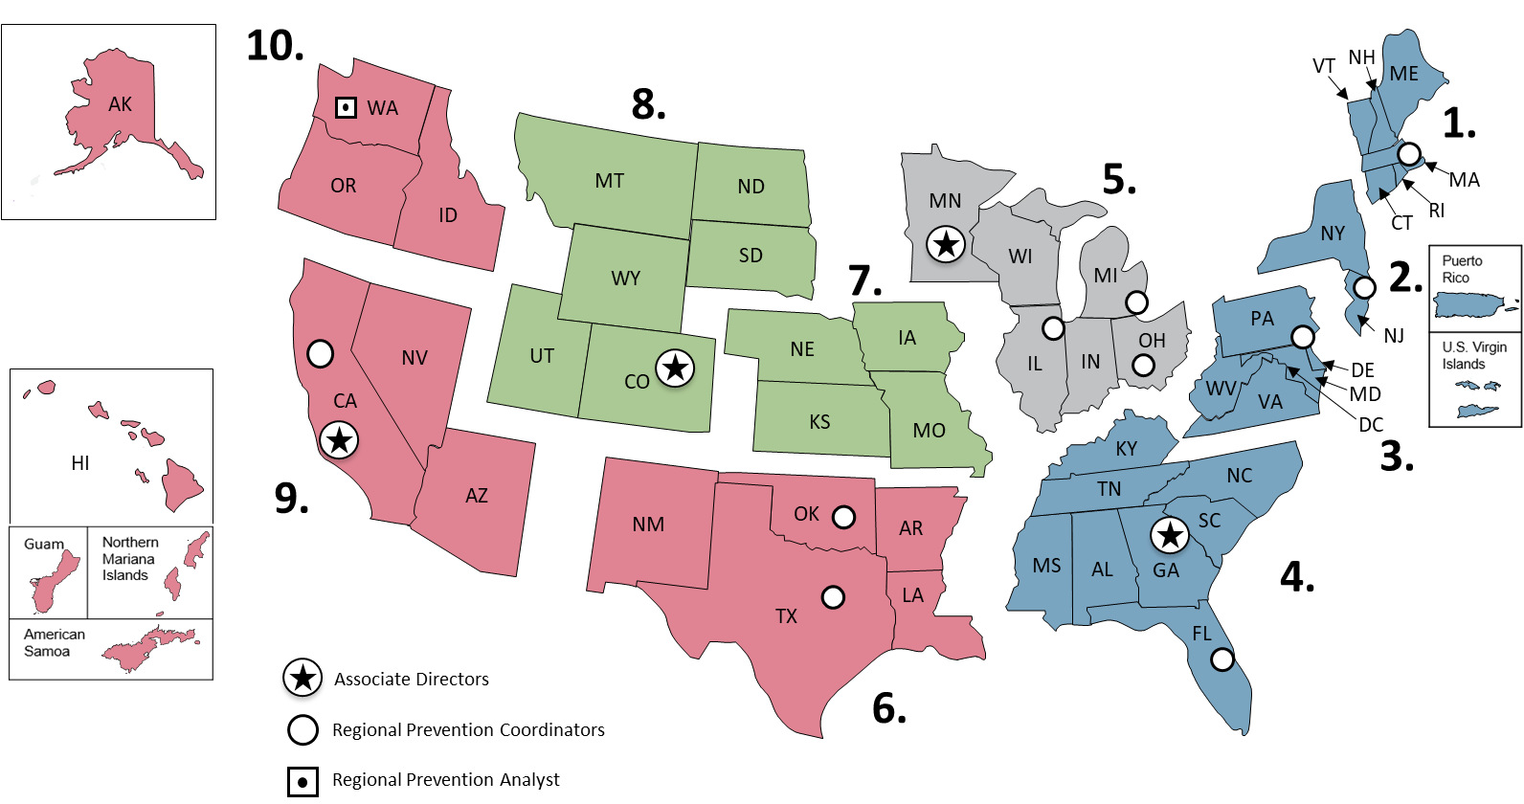
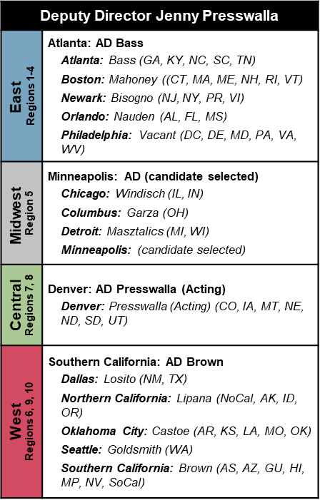
Field Staff Locations: Regional Prevention Coordinators

Slide 6


CP3 Mission: Prevention
Build Partnerships & Trust
Increasing Awareness
Instituting Intervention
Disruption
Re-Entry
Conducting Stakeholder Engagement & Convening Prevention-Focused Networks in Communities
Delivering Awareness Briefings & Conducting Tabletop Exercises
Coordinating & Supporting Local Intervention Programs
Investigations
& Arrests
Specialized Correctional
Programming
&
Access to Local Prevention
Programs
Prevention
Law Enforcement
Prosecutors
Corrections Probation
Parole
9/26/2022
Center for Prevention Programs and Partnerships

Slide 7
What is Terrorism?
“Terrorism” refers to violence committed in the name of ideology to further a political or social agenda.
In the United States, ideology, regardless of the cause it supports, is protected. However, force or violence on behalf of an ideology is not protected.
HOMEGROWN VIOLENT EXTREMISTS
RACIALLY/ ETHNICALLY MOTIVATED
ANTI-GOVERNMENT/ANTI-AUTHORITY
ANIMAL RIGHTS/ ENVIRONMENTAL
ABORTION-RELATED
ALL OTHER THREATS
OTHER
Center for Prevention Programs and Partnerships

Slide 8
What is “Targeted Violence”?
Intentional
Pre-planned act
Generate Publicity
Intimidate Target
Persons
Property
“Targeted violence” refers to any intentional act against a pre-identified target based on that target’s perceived identity or affiliation that is intended to intimidate or coerce or generate publicity about the perpetrator’s grievance.
Center for Prevention Programs and Partnerships

Slide 9
Prevention and Intervention
    Rehabilitation/Reintegration of individuals who have – or have planned to - engage in a targeted violence/terrorism act (High risk/high threat cases)
    Recidivism prevention
    Threat assessment and management by multidisciplinary teams for individuals who may have radicalized to violence
    Refer individuals to appropriate services as needed to deter violence
Empower bystanders to engage and connect individuals with the help they need
Invest in programs that reduce risks within communities and bring communities together
    Community wide policies and practices that prevent risk factors for targeted violence and terrorism from occurring
Center for Prevention Programs and Partnerships
Notes:
LEVEL 1
Community wide policies and practices that prevent risk factors for targeted violence and terrorism from occurring
LEVEL 2
Addressing risk factors/building protective factors
Empowering bystanders
LEVEL 3
Risk assessment/threat assessment for individuals who may have radicalized to violence
Refer individuals to appropriate services as needed to deter violence
LEVEL 4
Rehabilitation/Reintegration of individuals who have – or have planned to - engage in a targeted violence/terrorism act (High risk/high threat cases)
Recidivism

Slide 10



Appendix: Defining the Space
 | Targeted violence refers to any intentional act against a pre-identified target based on that target’s perceived identity or affiliation that is intended to intimidate or coerce or generate publicity about the perpetrator’s grievance.
 | Terrorism refers to a premeditated threat or act of violence, against persons, property, environmental, or economic targets, to induce fear or to intimidate, coerce or affect a government, the civilian population, or any segment thereof, in furtherance of political, social, ideological, or religious objectives.
 | Radicalization to violence is the process wherein an individual comes to believe that the threat or use of unlawful violence is necessary – or even justified – to accomplish a goal.
 | In the United States, ideology, regardless of the cause it supports, is protected. However, unlawful force or violence on behalf of an ideology is not protected.
 | Prevention frameworks integrate various programs to increase community resilience and reduce the number of individuals likely to radicalize to violent extremism, while identifying and intervening with individuals before violent or criminal acts occur. [1]
 | Intervention helps an individual move away from violence through noncoercive counseling, service provision, and other resources. Intervention programming (e.g., job training, mental health services, life skills counseling) is intended to produce changes in behaviors that should benefit the individuals involved. [2]
[1] paraphrased from CTTV Strategic Framework, pp. 22; [2] Ibid., pp 23, footnote 20.

Slide 11
Current CP3 Activities

Slide 12
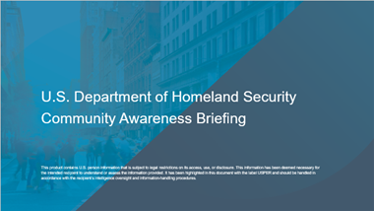
Training
CP3 provides training to help stakeholders understand the basics of targeted violence and terrorism prevention, including the behavioral threat assessment and management approach.
CP3 provides information to community members that integrates the latest in behavioral science through our trainings and table-top exercises:
  Community Awareness Briefing (CAB)
  Community Resilience Exercise (CREX)
CP3 also partners with the Federal Law Enforcement Training Center to develop and deliver Law Enforcement Awareness Briefings (LAB) that are tailored for Federal, State, and Local Law Enforcement Officers.
Learn More:
Request a CAB by emailing: cabbriefingrequests@hq.dhs.gov
Approach Alignment
Public Awareness & Education
Threat Assessment & Management
Support Services

Slide 13
TVTP Grant Program
The TVTP Grant Program is the primary financial mechanism through which CP3 supports the establishment and sustainment of local prevention efforts.​
In FY20 and FY21, CP3 funded a total of $30 million in programming to 66 recipients through the Targeted Violence and Terrorism Prevention Grant Program to address four priority areas:
The FY22 TVTP Grant Program adds an additional $20 million to support local communities prevent targeted violence and terrorism. FY22 Grants will address five priority areas:
Prevent Domestic Violent Extremism;
Establish and Enhance Local Prevention Frameworks With an Emphasis on Threat Assessment and Management Capabilities;
Promote Innovative Solutions for Preventing Targeted Violence and Terrorism; and
Challenge Online Violence Mobilization Narratives
Implementing Prevention Capabilities in Small and Mid-Sized Communities; ​​
Advancing Equity in Awards and Engaging Underserved Communities in Prevention;​
​Addressing Online Aspects of Terrorism and Targeted Violence; ​​
​Preventing Domestic Violent Extremism; and ​​
​Enhancing Local Threat Assessment and Management Capabilities.​
Learn More:
For more on the grants program and our grantees, please visit: https://www.dhs.gov/tvtpgrants
Approach Alignment
Public Awareness & Education
Threat Assessment & Management
Support Services

Slide 14
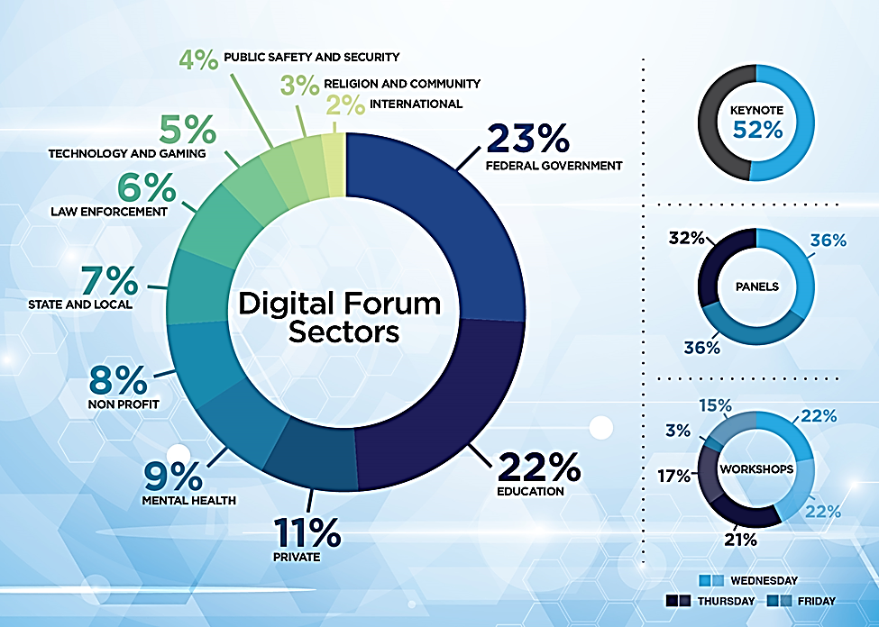
Strategic Engagement
CP3 collaborates with partners across all sectors at domestic national, interagency and international levels to support local efforts by building support for prevention from the top down.​
CP3 hosts quarterly, virtual Digital Forums to convene community leaders and companies to generate discussion about a topic of relevance to a sector
These engagements increase information sharing among prevention stakeholders
  Breakout of partner participation in Digital Forum Event.
Learn More:
Summaries of past Digital Forums can be found on our CP3 website at www.dhs.gov/cp3
Approach Alignment
Public Awareness & Education
Threat Assessment & Management
Support Services

Slide 15
Prevention Innovation
CP3 enables innovation in our approach to support prevention efforts across the country through the Invent2Prevent Program and the Targeted Violence and Terrorism Grant Program.
Invent2Prevent is a structured, experiential approach to learning that empowers students to create dynamic projects to prevent targeted violence and terrorism.
  College/University Program
  High School Program
  Sustainment Program
The TVTP Grant Program funds projects within the “Innovation Track” that approach the goal of targeted violence and terrorism prevention in new or untested ways.
  Includes projects that do not generally fall within the eight specified project types under “Promising Practices,” include a new theory of change that has not been previously implemented, or serve a unique or underserved target population.
Approach Alignment
Public Awareness & Education
Threat Assessment & Management
Support Services

Slide 16
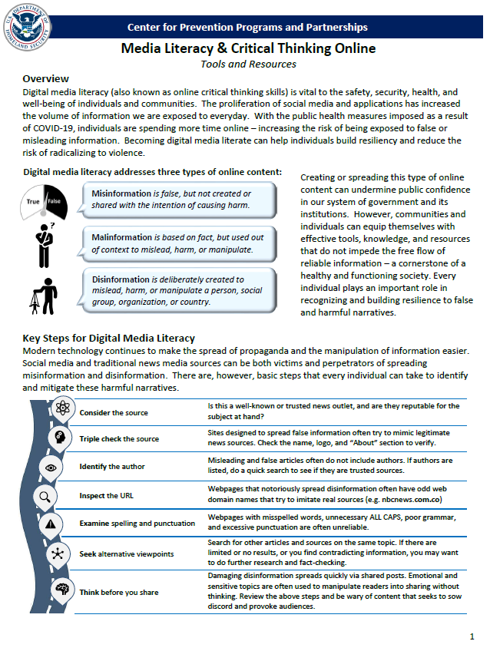
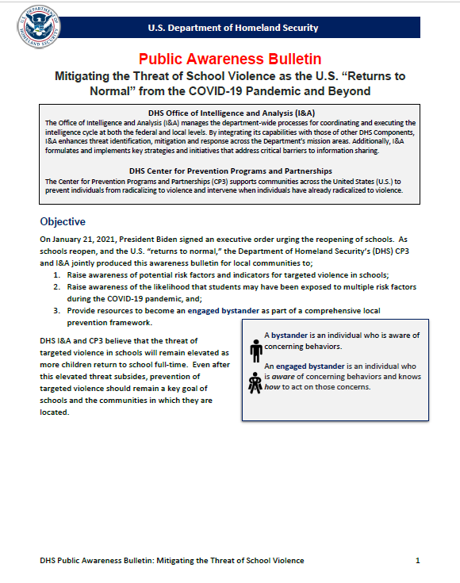
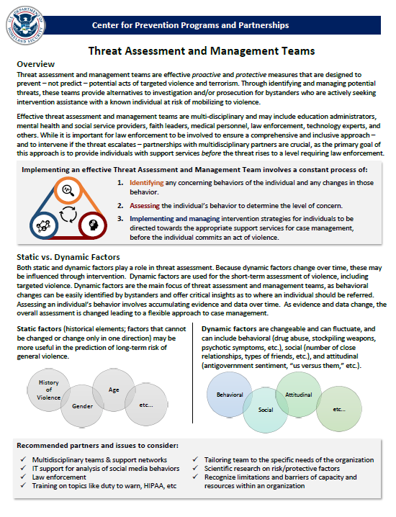
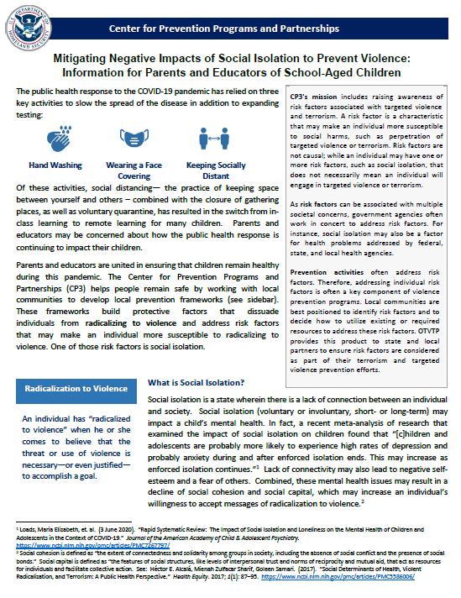
Prevention Resources
  CP3 produces and maintains public resources on prevention topics:
    Informational Products (e.g. fact sheets and academic digests)
  CP3 also develops operational guidance to support communities and local prevention efforts.
Learn More:
Access our Publications Library at:
https://www.dhs.gov/publications-library/preventing-terrorism
Subscribe to our listserv to stay up to date with CP3 at:
https://public.govdelivery.com/accounts/USDHS/subscriber/new
  Example information products produced by CP3
Approach Alignment
Public Awareness & Education
Threat Assessment & Management
Support Services

Slide 17
Pathway to Violence

Slide 18
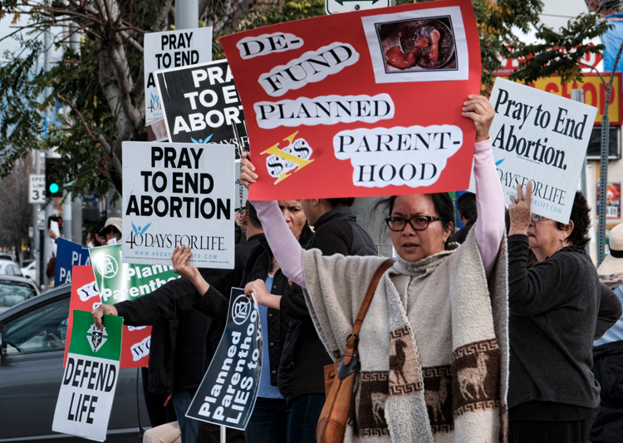
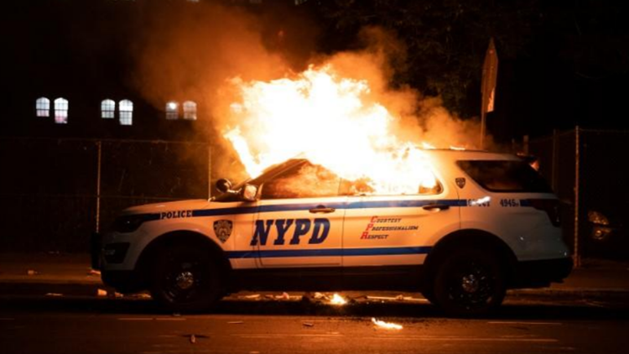
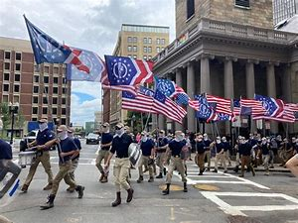
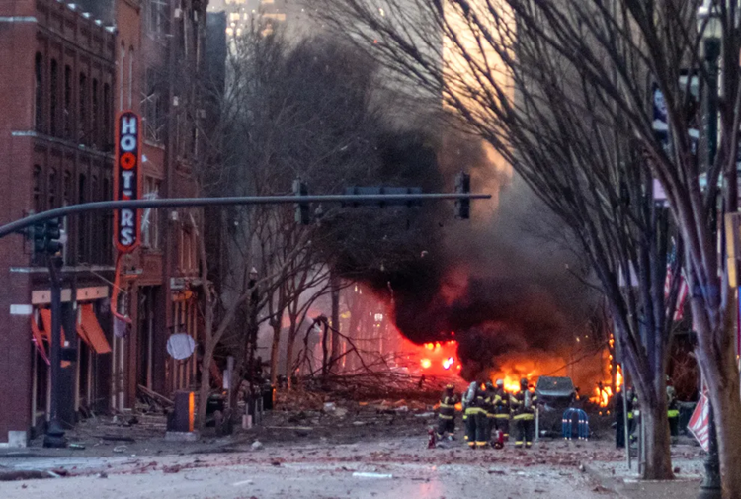
Notes:
Grievences

Slide 19
Understanding Radicalization and the Pathway to Violence
Radicalization to violence is the process whereby an individual comes to believe that the threat or use of unlawful violence is necessary – or even justified – to accomplish a goal.
Mobilization to violence is the process by which individuals take action to prepare for or engage in violence or material support of violence to advance their cause.

Slide 20
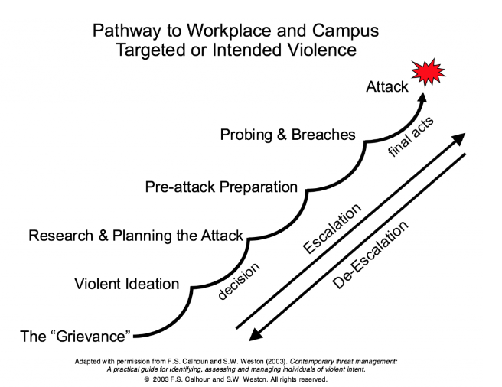
Common Pathway to Violence

Slide 21
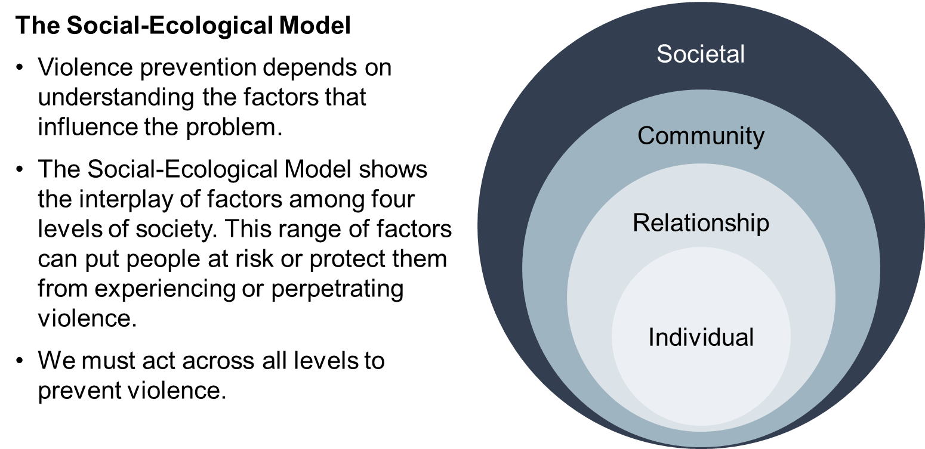
Understanding the Factors That Influence Violence: The Social-Ecological Model

Slide 22
The Mentality of Attackers
Most attackers are not mentally ill (approx. 8% have a serious mental illness), but they all are mentally unhealthy (stressors, poor coping skills, lack of buffers against violence, no outlook/last resort belief) (Gary Brucato, 2021)
Most attackers are pathologically fixated (81%) (J. Reid Meloy, 2022)
Threatening or concerning communication (leakage) precedes most acts of mass violence (60-90%) (J. Reid Meloy, 2022)

Slide 23
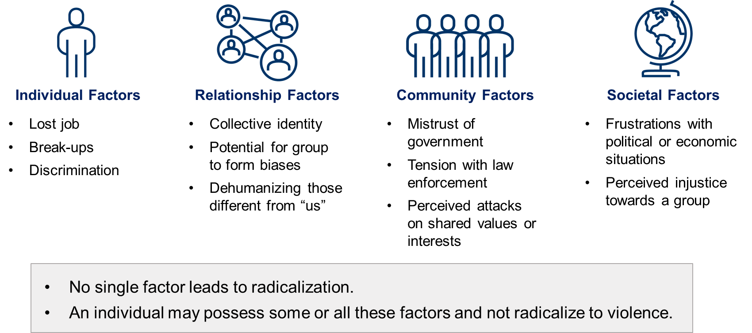
Examples of Factors That Could Influence Radicalization to Violence

Slide 24
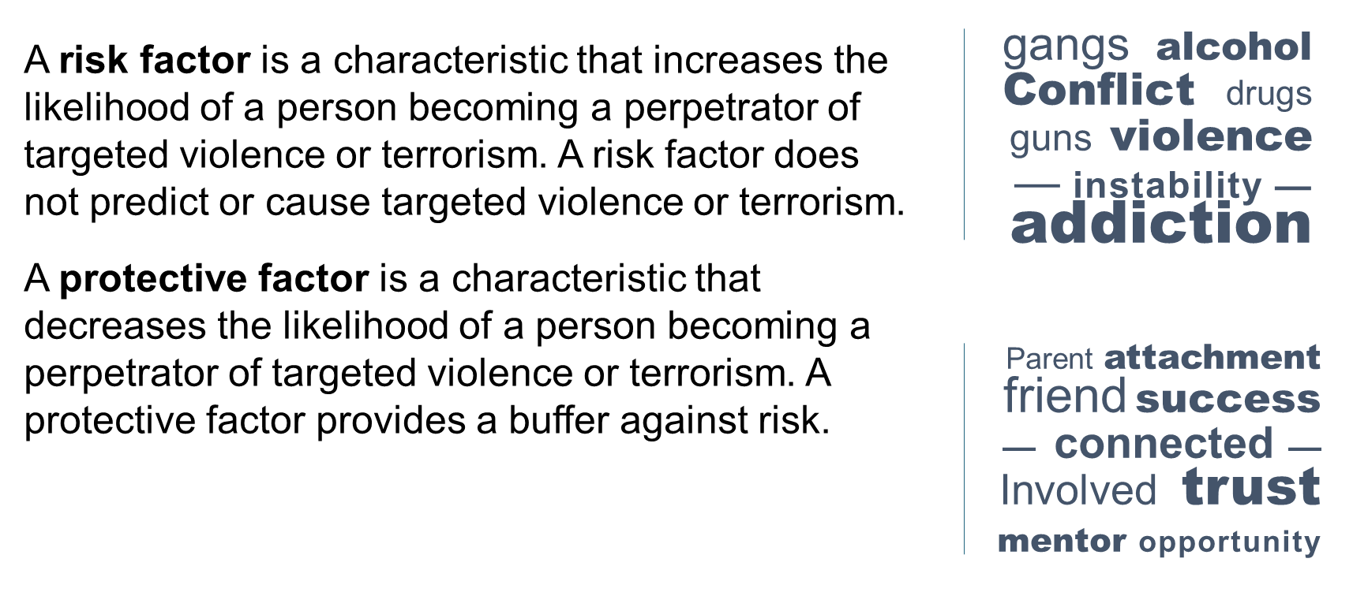
Risk and Protective Factors

Slide 25
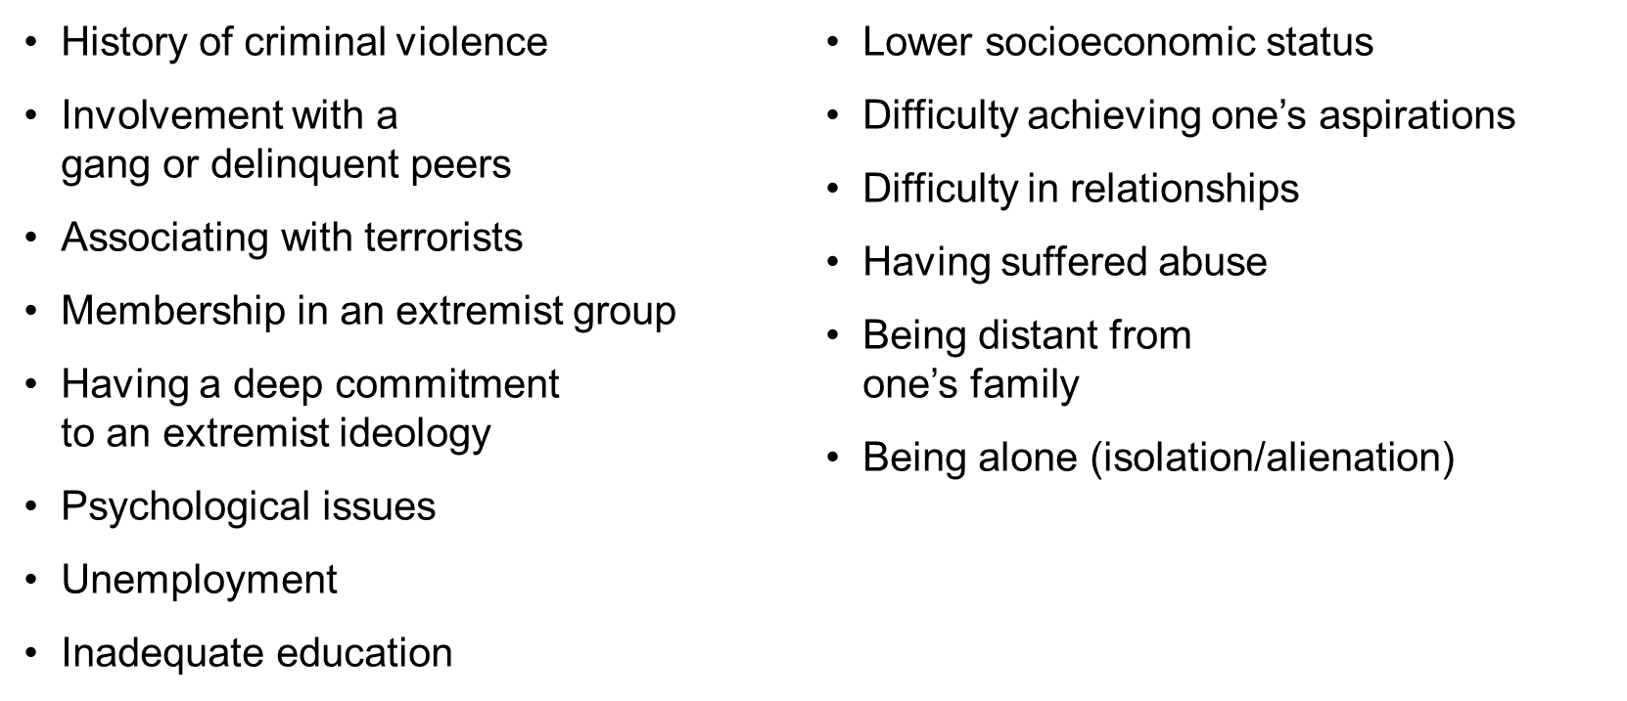
Examples of Potential Risk Factors for Terrorism

Slide 26
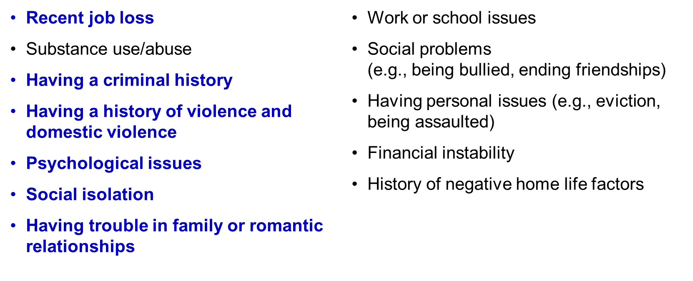
Examples of Potential Risk Factors for Targeted Violence

Slide 27
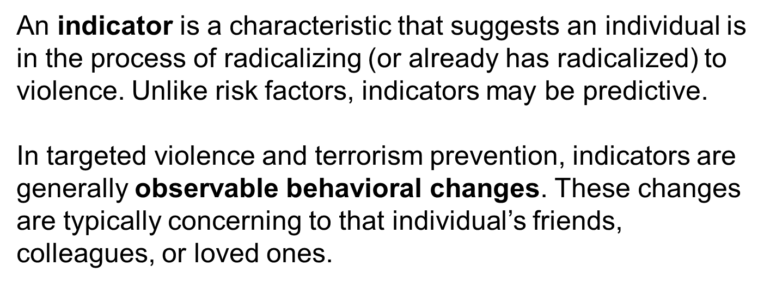
What Are Radicalization to Violence Indicators?

Slide 28
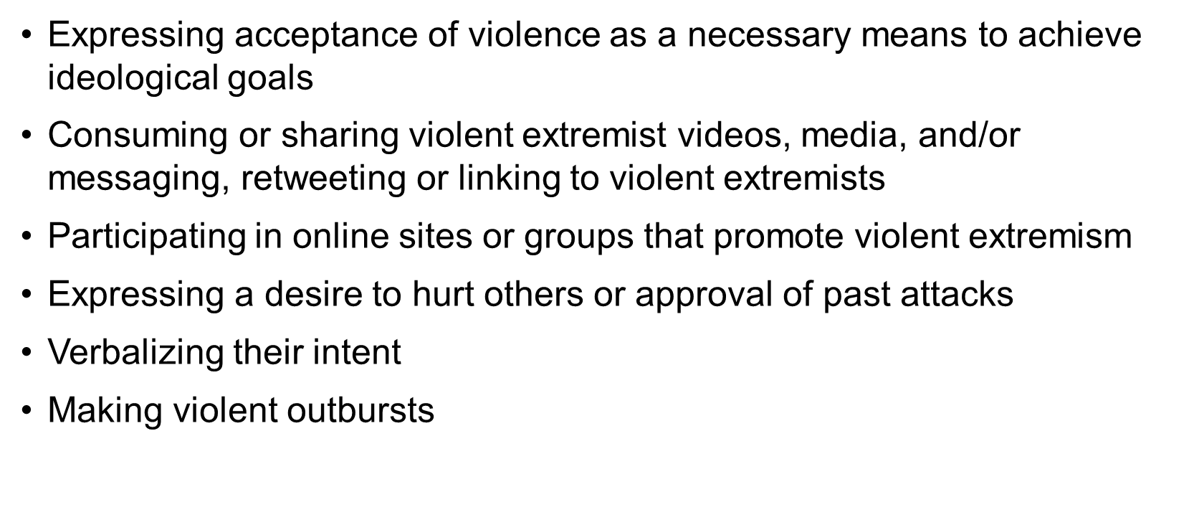
Examples of Potential Radicalization to Violence Indicators

Slide 29
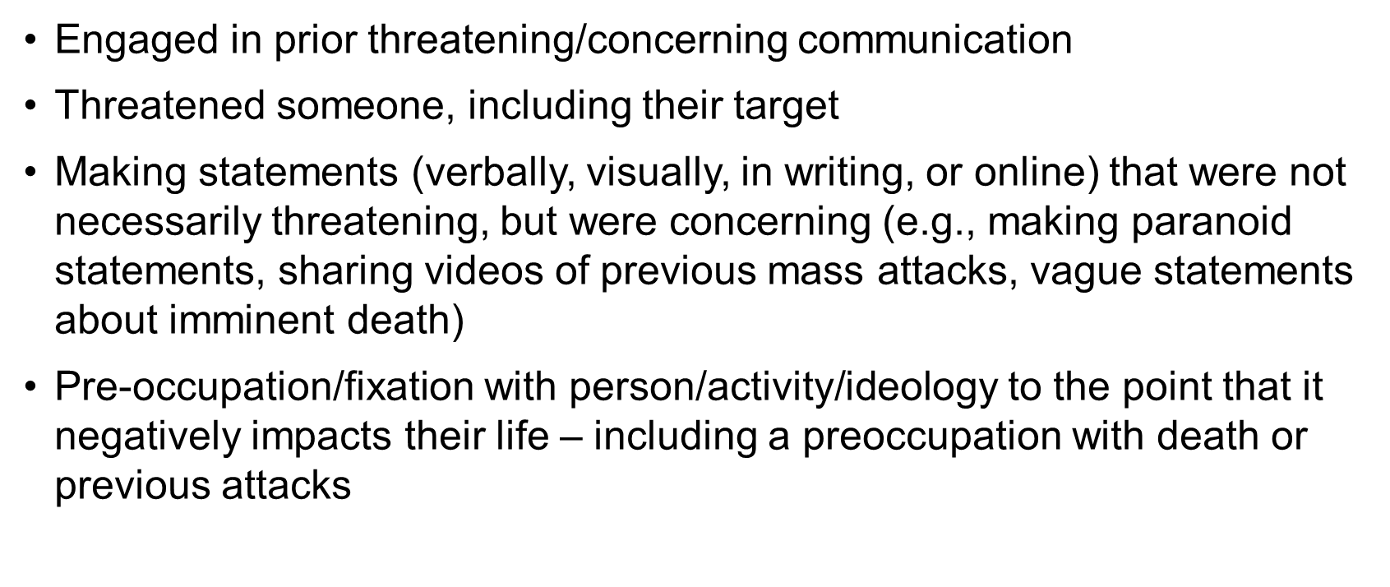
Examples of Potential Radicalization to Violence Indicators, continued

Slide 30
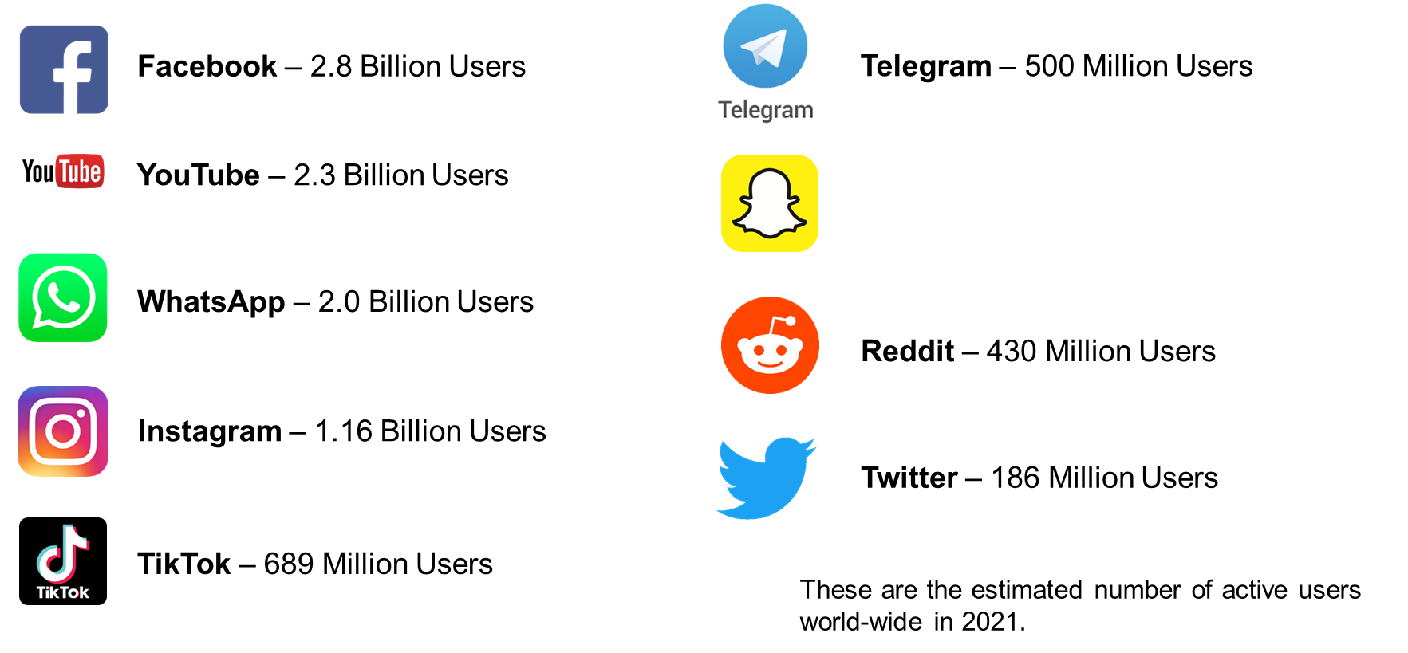

Online Environment

Slide 31

Online Environment

Slide 32

Alternative Audience-Specific Platforms

Slide 33
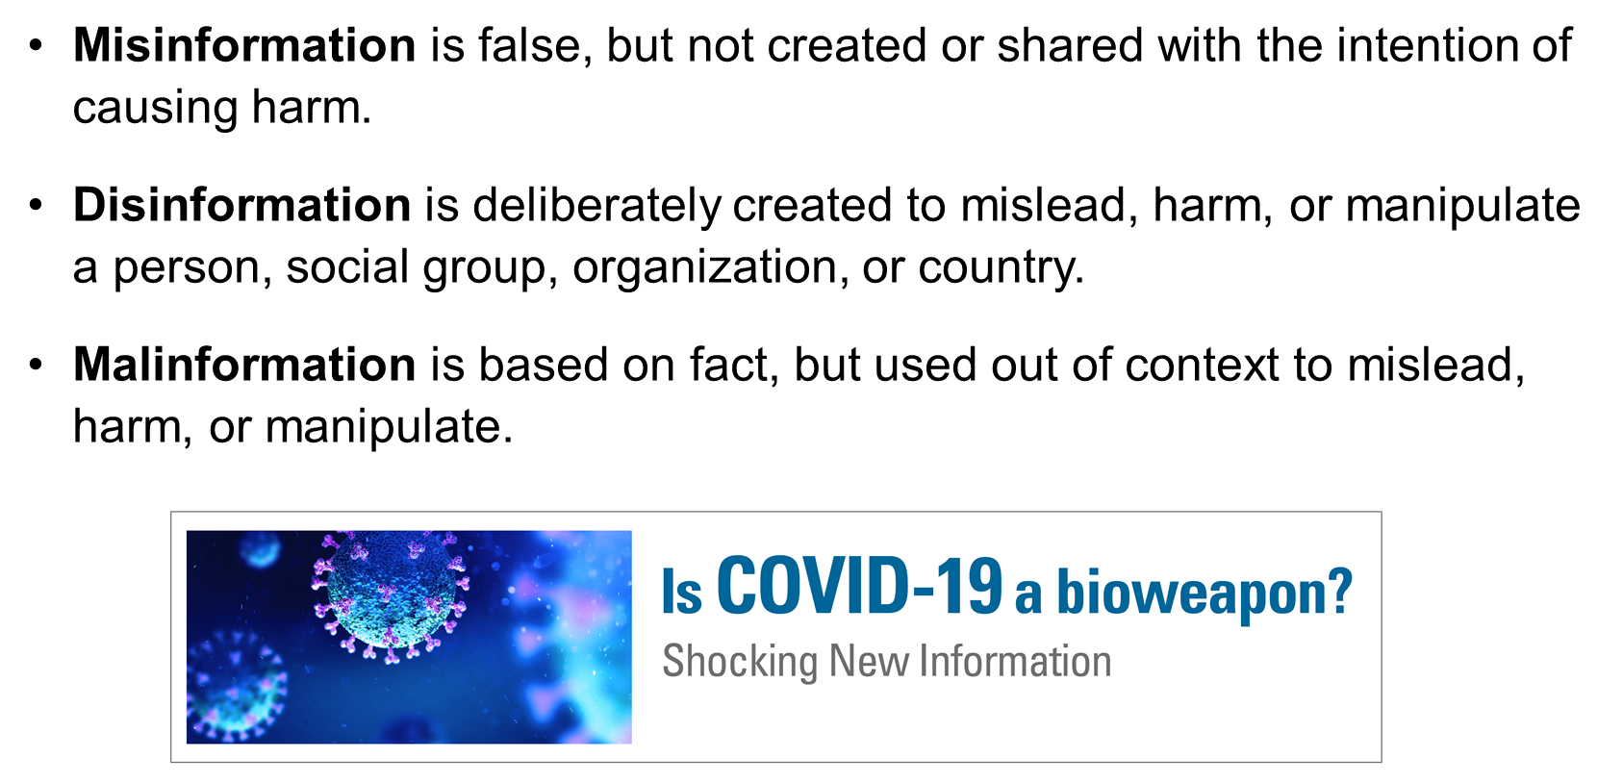
Violent Extremists Use Misleading Information

Slide 34




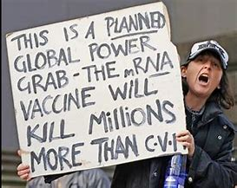
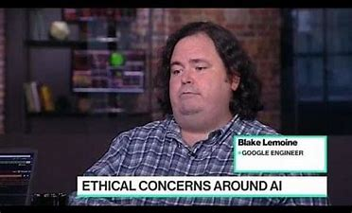
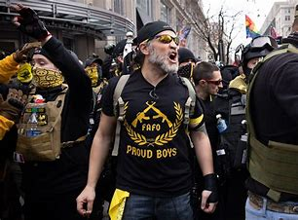
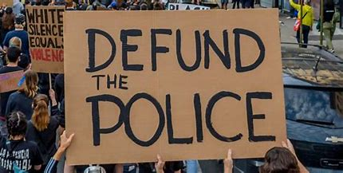

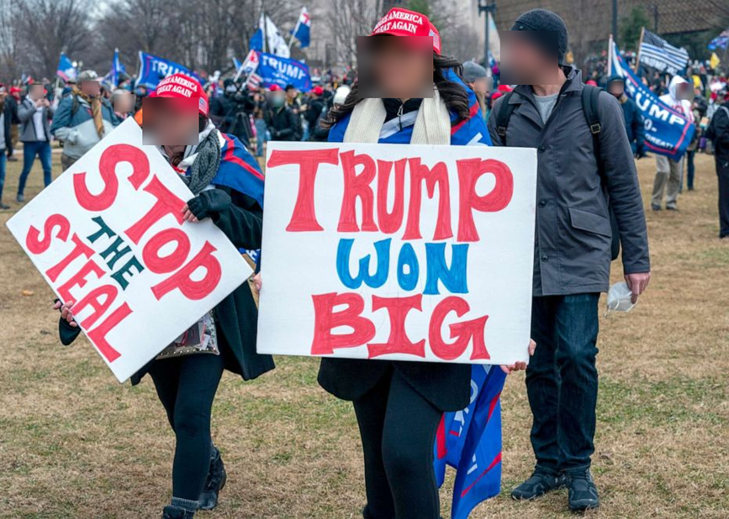
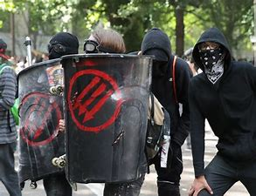


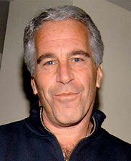
Persuasive Narratives, Conspiracy Theories, Identity & Community

Slide 35
Case Studies

Slide 36
Case Study: Example 1
From a young age into adulthood, displayed aggressive behavior and a lack of self-control. Was suspended several times in school and expelled once before transferring to a school for individuals with behavioral issues.
Described as socially isolated and had a difficult time relating to others.
Expressed an interest in working for law enforcement and earned an associate degree in criminal justice.
Was not able to pass the State’s Law Enforcement Basic Abilities Test to become a state highway patrol officer and was expelled from the Department of Corrections for suggesting that they would bring a gun to class.
A history of making comments directed at coworkers about past terrorist attacks. Subsequently, was investigated by the FBI.
Family members reported that individual was abusive but claimed no signs of violent extremism.
Researched potential targets and previous successful homegrown violent extremist attacks months before own attack.
Changed the primary beneficiaries of bank accounts in the event of death and transferred share of the home that was owned to family members for $100.
A few weeks before the attack, researched State’s gun regulations, legally purchased a rifle and a handgun, attempted to buy high-end body armor and bulk ammunition, and racked up $25,000 in credit card debt buying jewelry and clothing for family, as well as giving family money for a trip.

Slide 37
Case Study: Example 2
Individual 1
Grew up in an abusive home where drugs and violence were common
Had suicidal and homicidal thoughts since 12
Publicized homicidal thoughts on social media
Was prone to self-harm and suicidal ideation. Began cutting themselves at 13 and was hospitalized more than once.
Was made fun of in school
Told bystanders of planned attack for weeks and intended to target those who repeatedly mocked the individual.
“wanted people to experience bad things [and] suffer from trauma,” and that “he wanted everyone to suffer and realize that the world is a bad place.”
Parents owned a safe with firearms
Individual 2
Talked about causing a lot of harm and sadness
Social media presence did not suggest anything out of the ordinary
Claimed that Individual 1 pressured them into doing attack

Slide 38
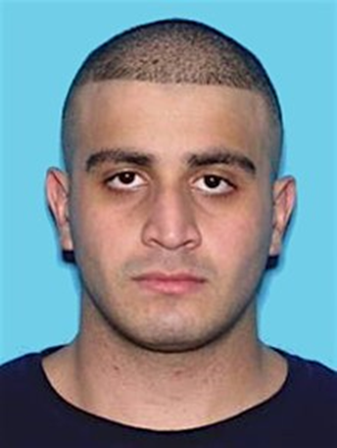
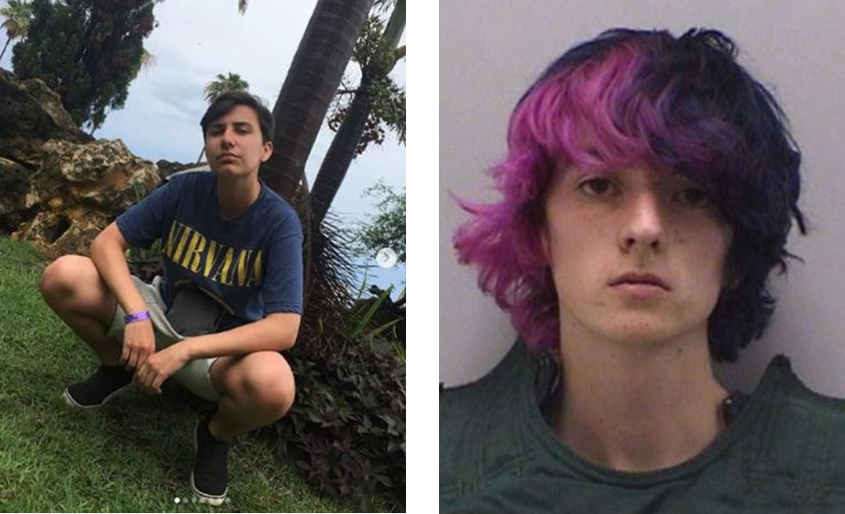
Case Studies 1 & 2
In the early morning hours of June 12, 2016, Omar Mateen opened fire on the Pulse Nightclub in Orlando, Florida, killing 49 people and injuring 53 more, before he was shot and killed by police following a hostage situation. The attack lasted several hours and remains the deadliest terrorist attack on U.S. soil since 9/11
On May 7, 2019, Alec McKinney, 16, and Devon Erickson, 18, walked into a classroom at STEM School Highlands Ranch in Highlands Ranch, Colorado, and opened fire with handguns. The pair injured six students and killed another.
McKinney pleaded guilty to murder charges and was sentenced to life in prison. Erickson was convicted on 46 charges including criminal attempt to commit murder and is awaiting sentencing.

Slide 39
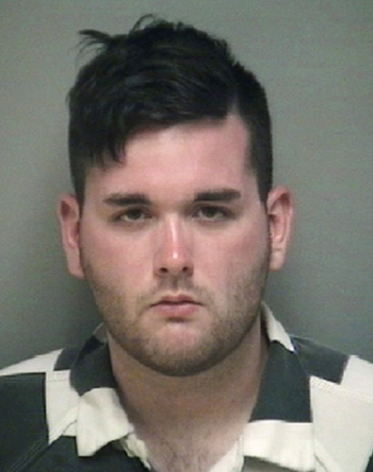
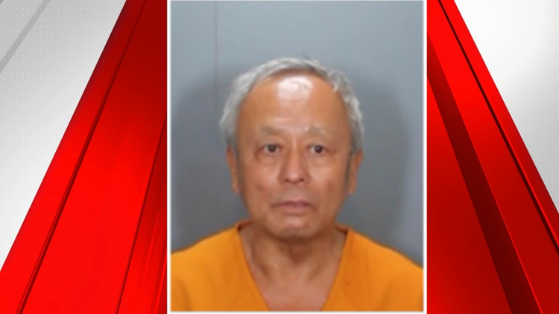
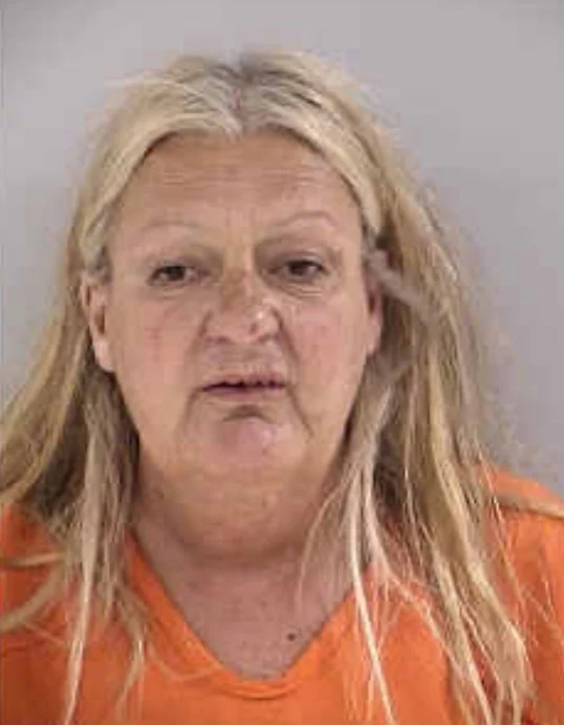
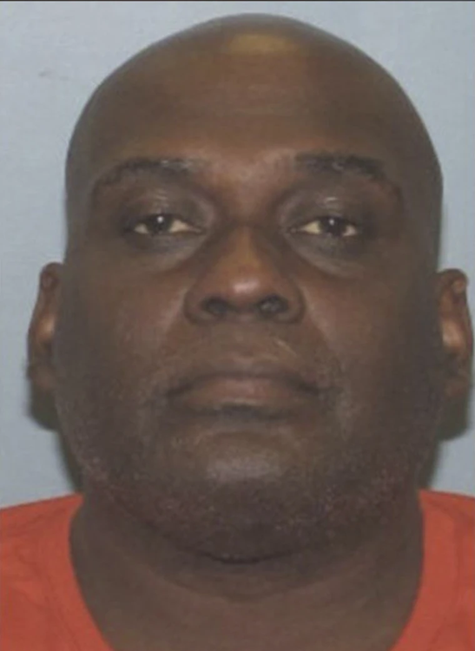
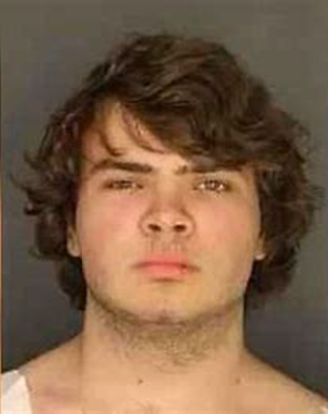
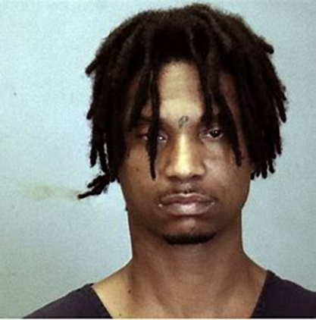
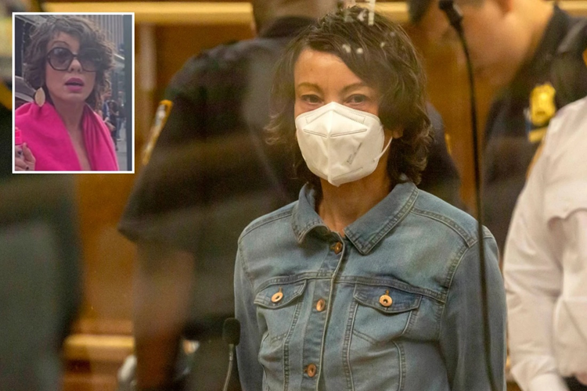
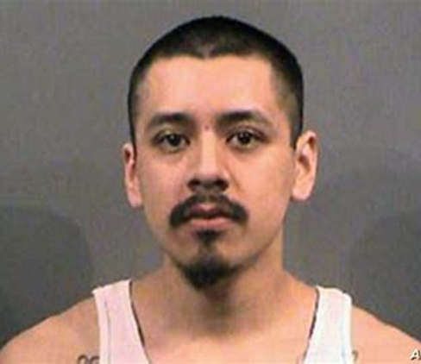
Notable Examples
Notes:
James Alex Fields: Charlottesville VA, drove car into protesters.
David Chou: CA- Shot up Taiwanese presbyterian church. Chinese Nationalist
Suzette Gay Thompson: MN, set fire to Islamic center
Frank James: NY, Subway shooter
Justin Tyran Roberts: Alabama, shooting, targeting white men
Peyton Gendron: Buffalo shooting, Race/replacement theory
Madeline Barker: NY, Anti-Asian pepper spray: “Go back where you came from”
Armanso Sotelo: Kansas, Assault on Somali men

Slide 40
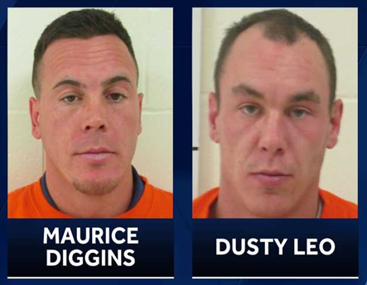
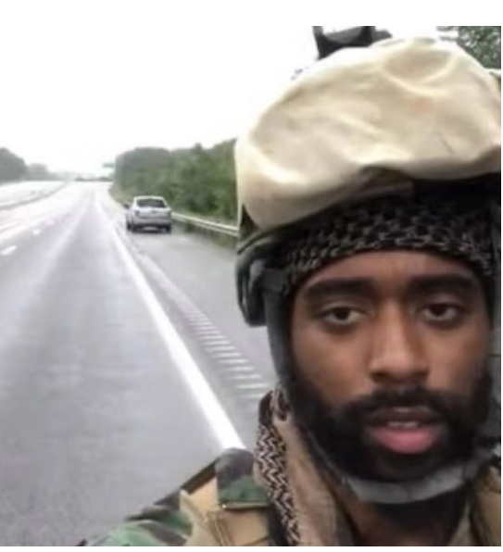
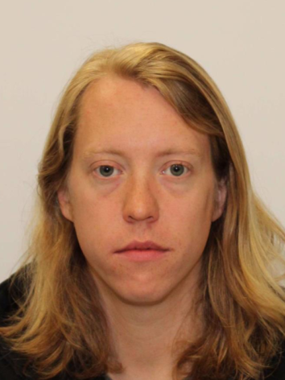

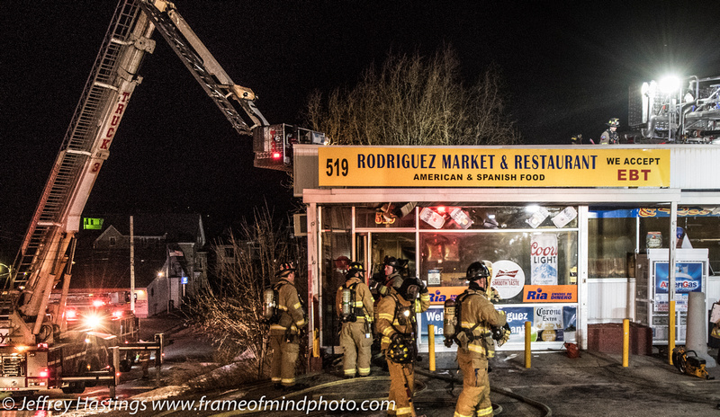
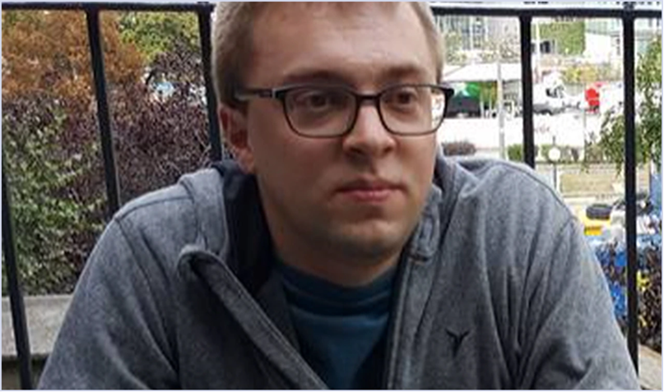
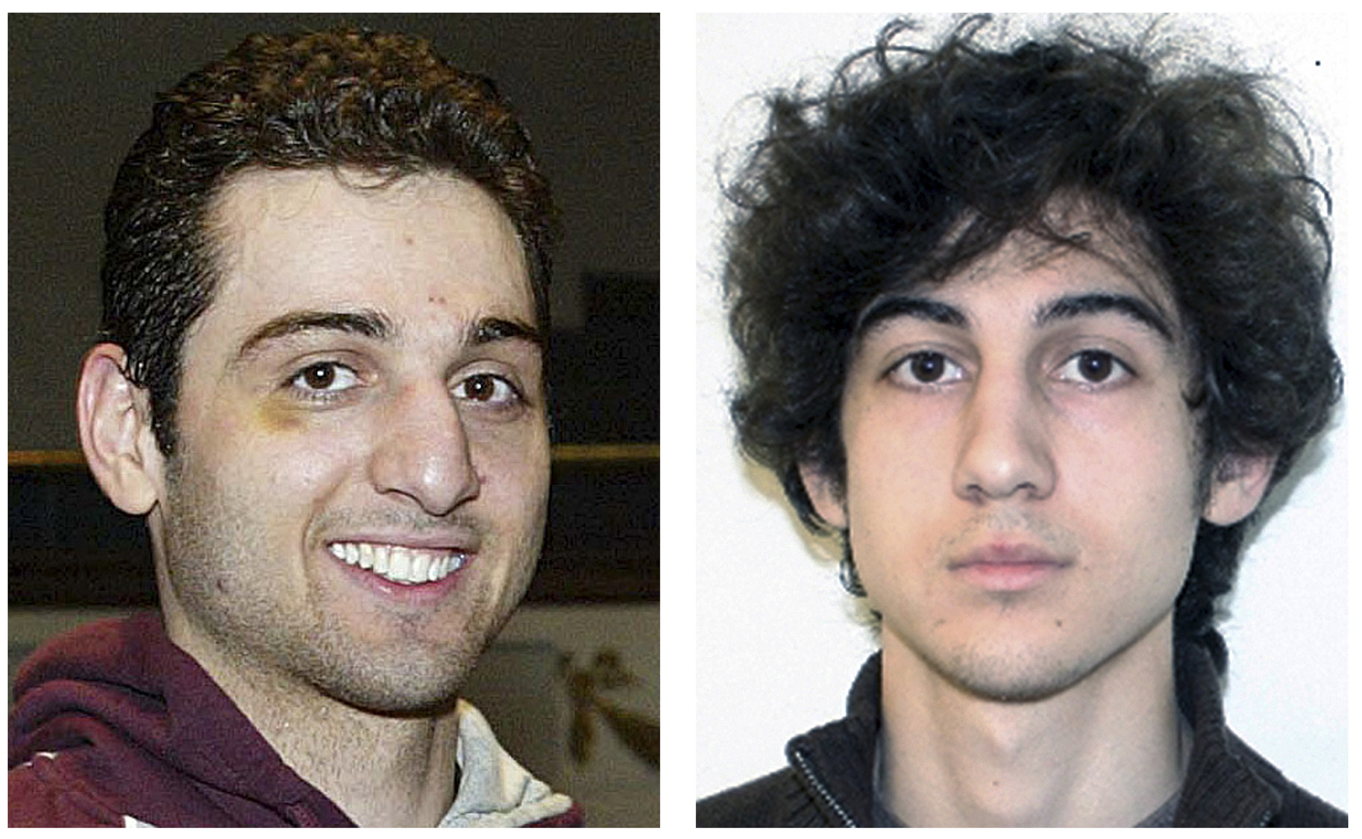
New England Examples
Notes:
Maurice & Dusty: Biddeford ME: White Supremacy; Assault on Black men
Jamal Talib Abdullah Bey: Rhode Island; Ride of Moors; Anti-Government
Rodriguez Market: Manchester NH, Vandalism KKK
Aaron Loukes: Burlington VT; COVID-19 Vaccine; Firearm possession
Adam Lanza: Sandy Hook CT
Tsarnev Borthers: Massachusetts; Boston Marathon Bombing
Nathan Allen: Winthrop MA; Racial attack on blacks shot, possible Anti-semetic

Slide 41
Whole of Society Prevention

Slide 42
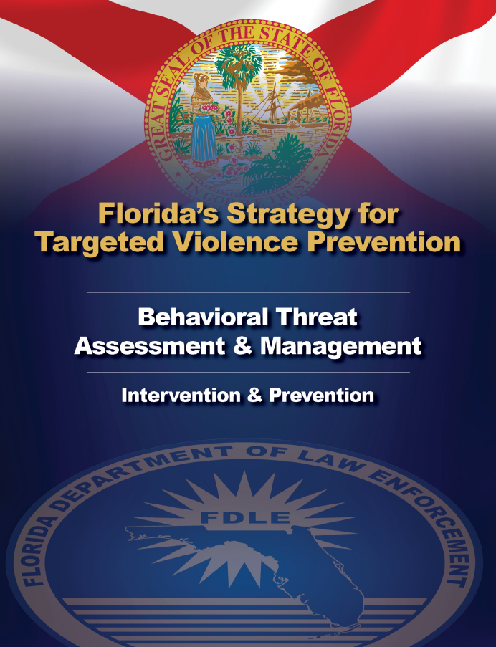

Prevention Strategies Across the United States
Missouri
Ohio
(Michigan)
West Virginia
Oklahoma
Wyoming
Colorado
Utah
Illinois
Hawaii
New York
Wisconsin

Slide 43
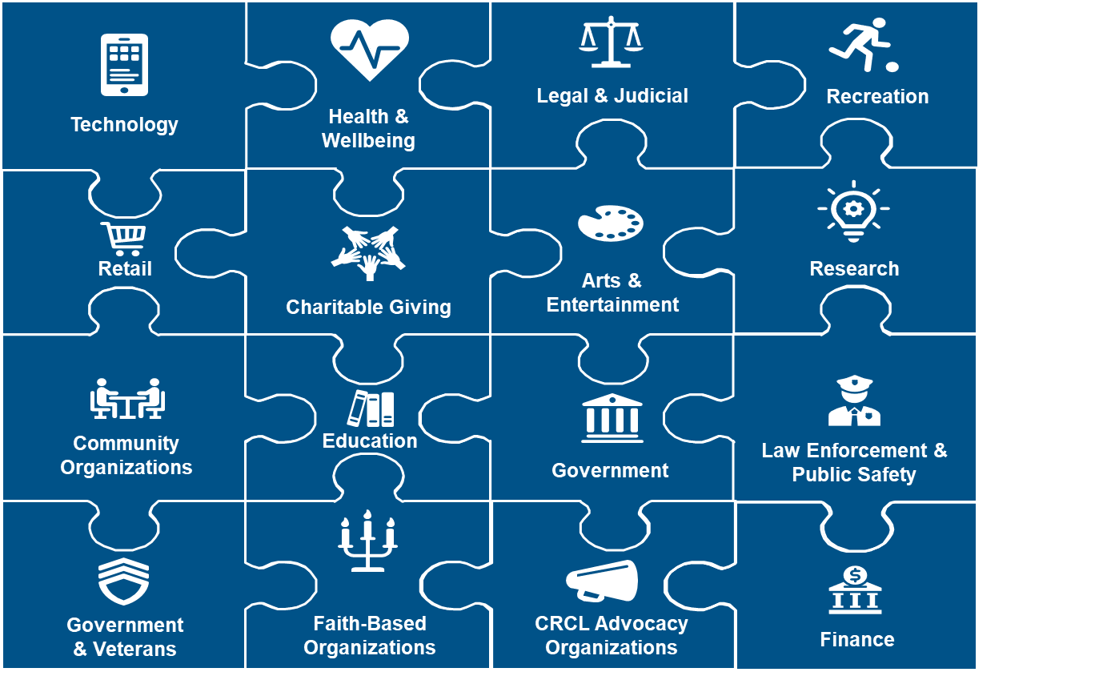
Prevention in Practice
Center for Prevention Programs and Partnerships

Slide 44
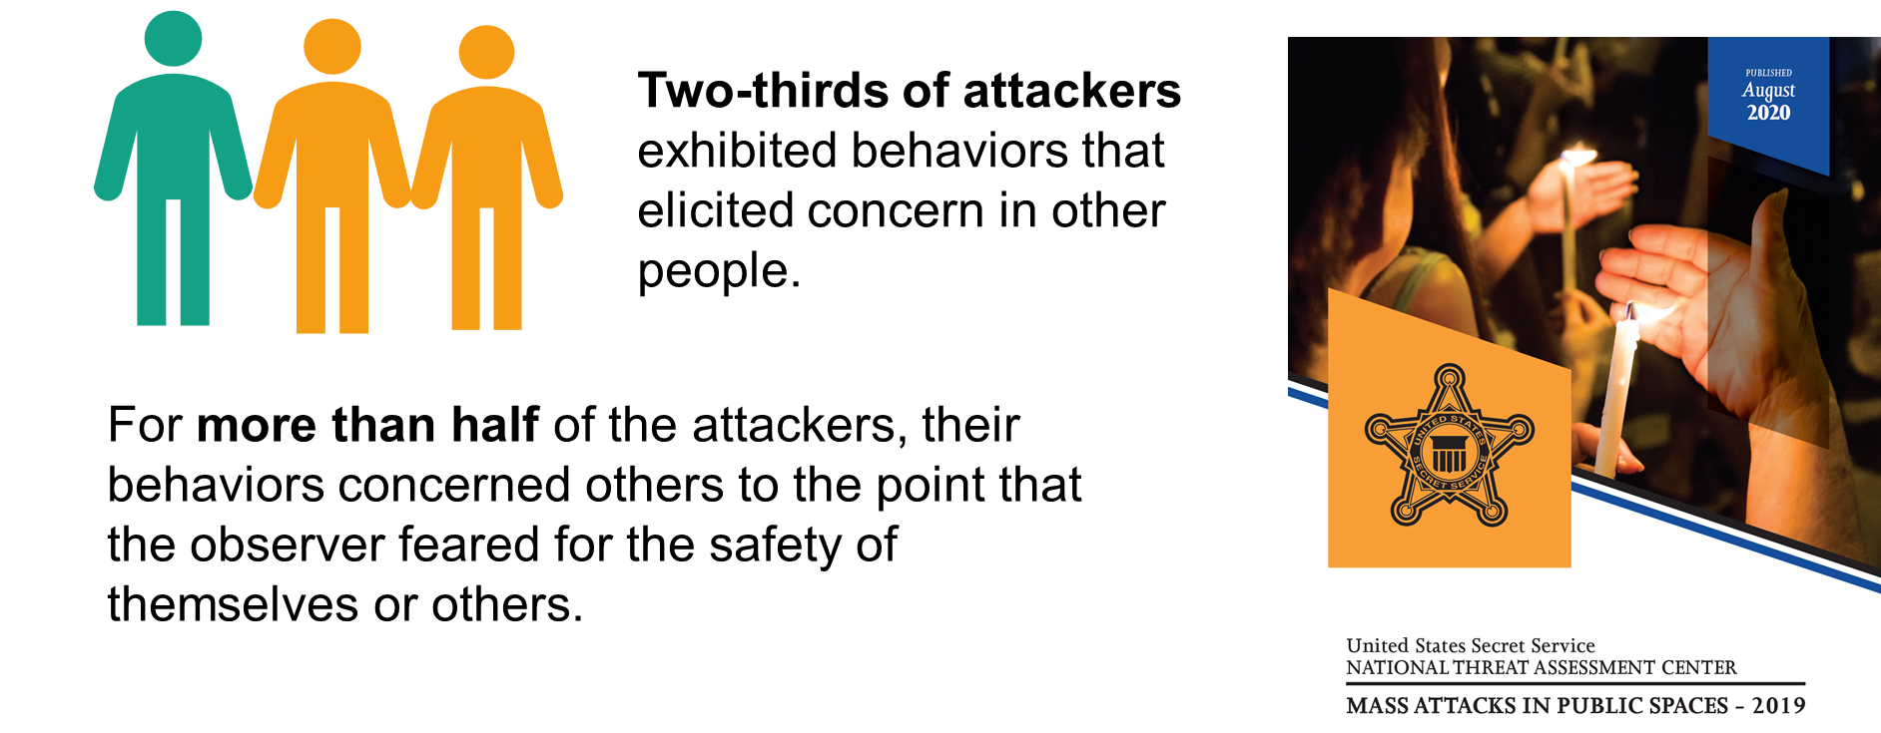
Bystanders Can Help
Center for Prevention Programs and Partnerships

Slide 45
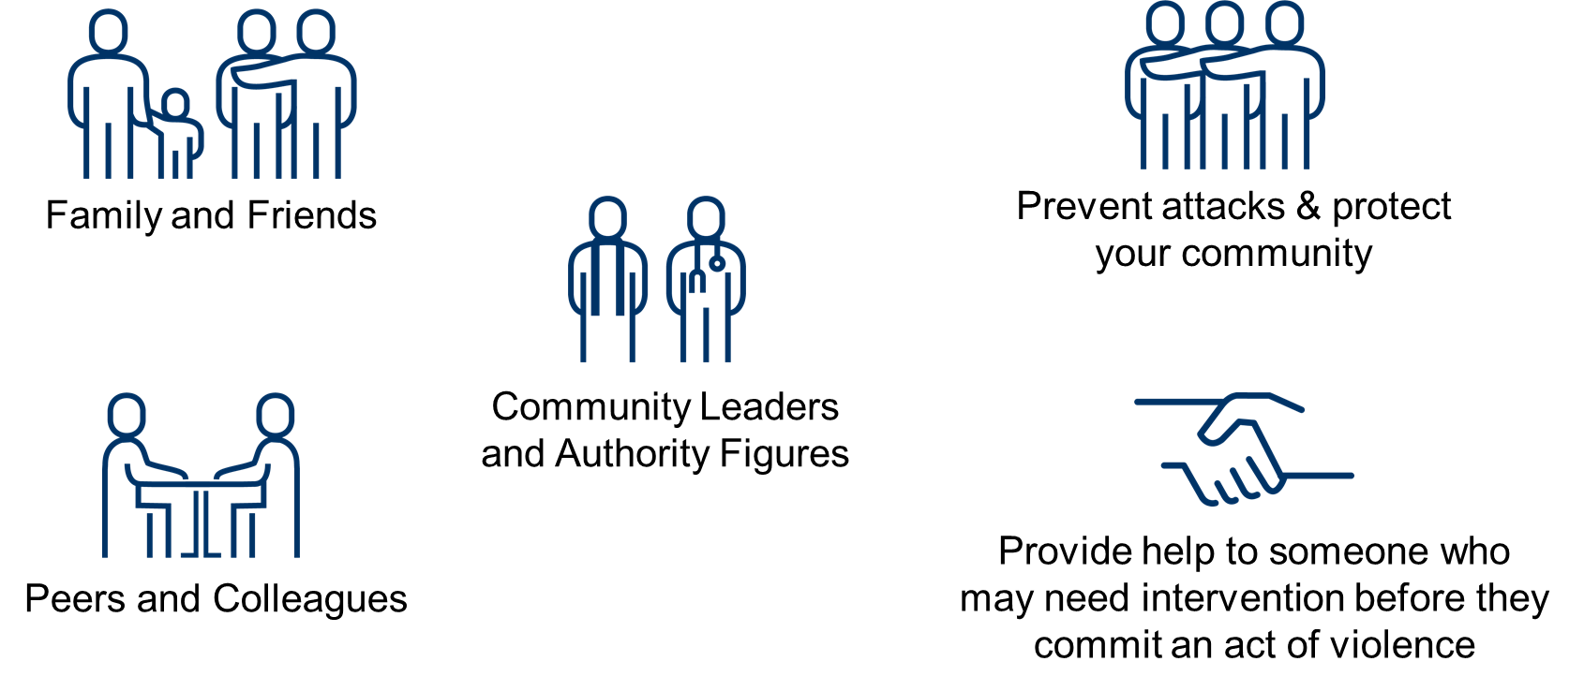
Who Are Bystanders and What Can They Do?
Center for Prevention Programs and Partnerships

Slide 46
What Is a Threat Assessment?
Identifies individuals who exhibit threatening or concerning behavior.
Gathers information to assess whether they pose a risk of harm.
Identifies appropriate interventions, resources, and supports to manage that risk.
Center for Prevention Programs and Partnerships

Slide 47

What Is a Multidisciplinary Team?
Center for Prevention Programs and Partnerships

Slide 48

Ingredients of Prevention Initiatives
Center for Prevention Programs and Partnerships

Slide 49
Areas for Future Collaboration & Coordination
Are you aware of any other people or groups we should contact that are undertaking related work in this field or using similar methods to address a societal problem?
Do you know of any other existing prevention and intervention programs we can connect with that are designed to stop violence or promote community resilience?
  Examples Include: Threat management programs, school safety programs, local intervention networks to help youth, and gang intervention programs
Center for Prevention Programs and Partnerships

Slide 50
More CP3 Information
Robert F. Mahoney
617-519-3791 (mobile) robert.mahoney@hq.dhs.gov
CP3 Field Requests: CP3Field@hq.dhs,gov
Education Request(s): cabbriefingrequests@hq.dhs.gov
Website: www.dhs.gov/cp3
TVTP Grants Information: https://www.dhs.gov/tvtpgrants
Subscribe to CP3 Listserv: https://public.govdelivery.com/accounts/USDHS/subscriber/new
Prevention Resources: https://www.dhs.gov/publications-library/preventing-terrorism

