Slide 1
COVID COMS
Parks & Rec crisis communications during the COVID-19 pandemic.
TAKE THE SURVEY

Slide 2
Keys to Success
Photo by Keith Luke on Unsplash

Slide 3
Be Accurate & Consistent
Be sure the information you're putting out is absolutely correct.
Everyone should be sharing the same message
Run it by leadership and the team
Notes:
Provide correct & accurate info
To support this, we needed strong guidance and streamlined communications.
The Mayor's office did a good job of it, and our internal staff was able to react and collaborate quickly
Stay consistent
Tone of voice. We were very official and tried to tie in to the rest of the City departments
The dedicated web page was update frequently and only had current info on it
Use the same outlets: social media, signs
Dedicated person or team with good collaboration
The city has loosely organized groups of communication specialist, but there was a COVID coms team formed, and then the RRC
at some point things and roles shifted, but that wasn't communicated clearly to all staff. I'm uncertain where that broke down.
Who can provide an example of great collaboration?

Slide 4
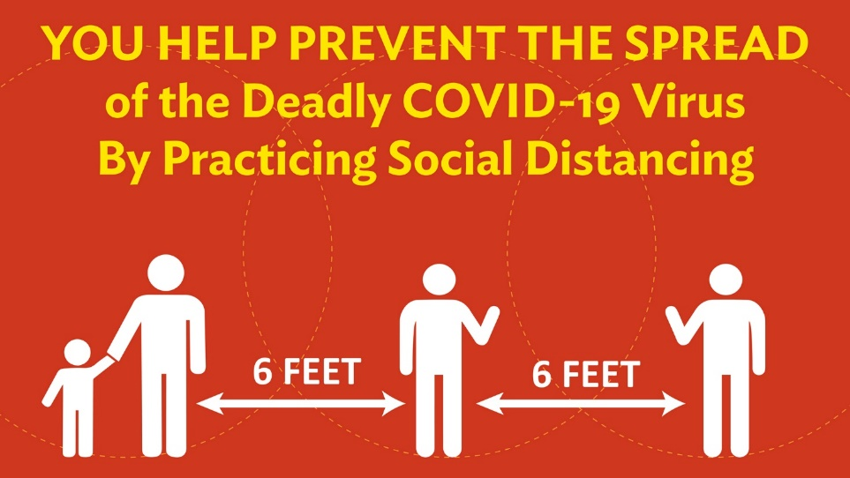
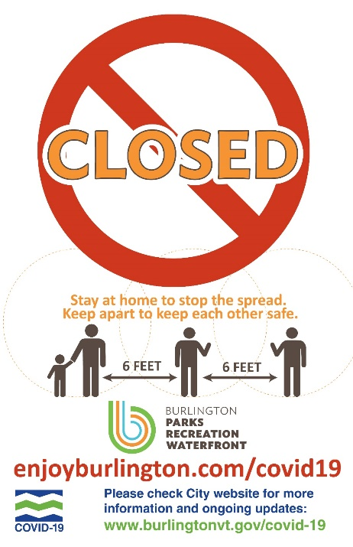
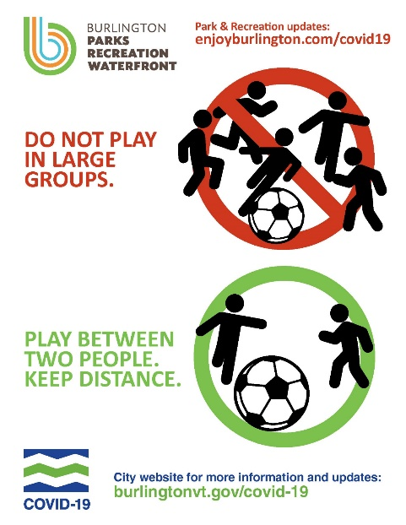
Be Responsive
Be ready to pivot. Agile. Quick.
Know your audience & how to reach them
Have your tools and teams ready
Notes:
We updated the websites asap and posted social
Quick laminated in-house signs went out with a day or two
I created about 26 quick signs for buildings and parks
There were 6 lawn signs for the parks
Cost and
time for the staff to get them out!
More permanent signs out as quick as we could get them printed. At first it was hard to find a printer!
How fast did you react?

Slide 5
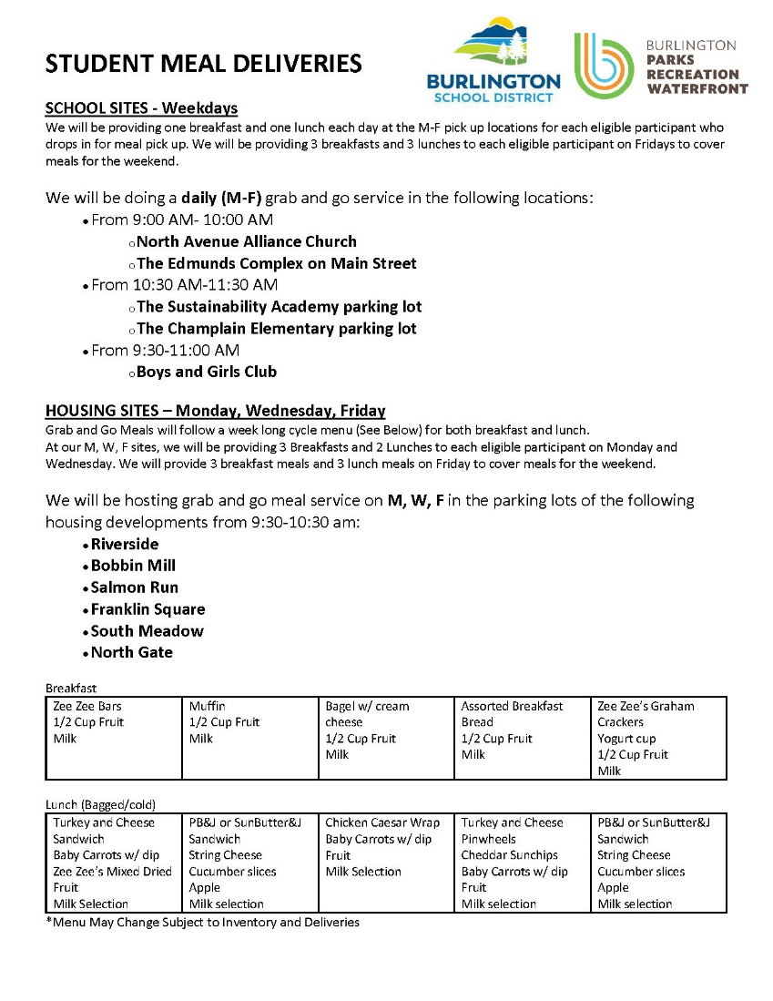
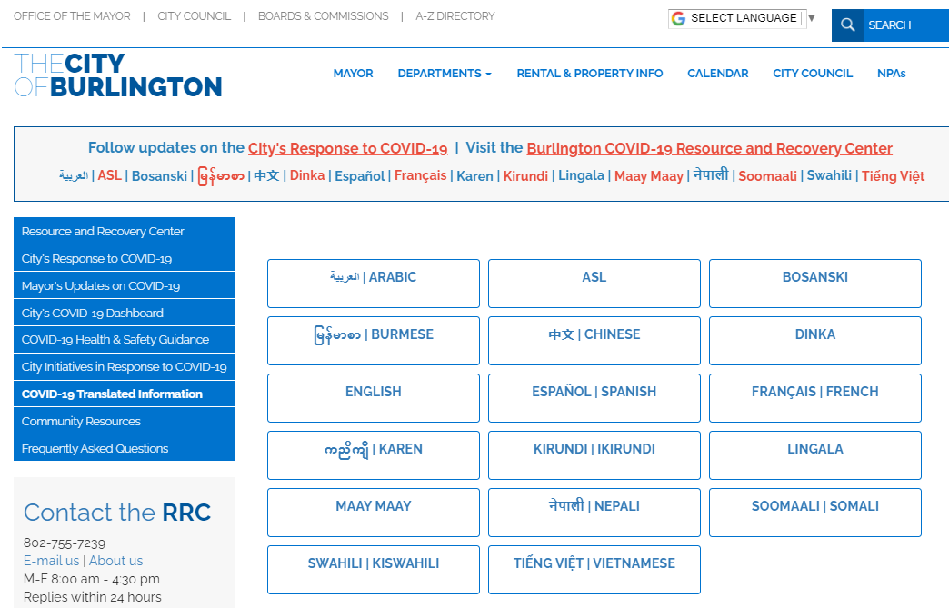
Reach As Many People As Possible
Use a wide range of outlets
Reach people where they are
Work with community partners
Notes:
Types of communication
Signage
Social media
Website
Distributed flyers etc
At location, meet people where they are, but sometimes that's too late
Being as proactive as possible so park users didn’t arrive to a location only to find it closed

Slide 6
Lesson Learned: Plan Ahead
Write an emergency communications plan
Organize and response team
Have tools & resources ready
Earmark financial resources to cover the costs
Photo by Kelly Sikkema on Unsplash
Notes:
To honest, we did NOT have plan! Yes we have EAPS and location specific plans, but nothing quite prepared us for a global pandemic.
Did anyone have an emergency communications plan in place?
Was there a team? Who would you go to?
Did you know where to get signs made?
Who was going to PAY for all of this?
We did eventually have some funding available for covid specific stuff. Otherwise, it would have eaten up most of annual budget!

Slide 7
Looking Ahead
Photo by nine koepfer on Unsplash
Notes:
Will you change anything you're doing to communicate the ongoing changes during this Pandemic?
Yes! Need to do better with reaching our non-english speakers. The city creates a group called "trusted community voices" to help disseminate info. I've only recently been in touch with them. They will be super helpful and I hope we can keep this going for non-crisis topics too!!!
Will you create a communication plan for crises?
Um… yes! Adding this to my Marketing Plan!
Will you continue or discontinue to use any of the tactics you introduced?
Example: videos! We increased our use of them for recreation and communications. Although they didn't get the bog reactions an numbers of views we hoped for, they we're very effective to tell complex stories.

